Slide 1
Topic: Least squares regression line and residuals
EQ: What is the relationship between a least squares regression line and residuals?

Slide 2
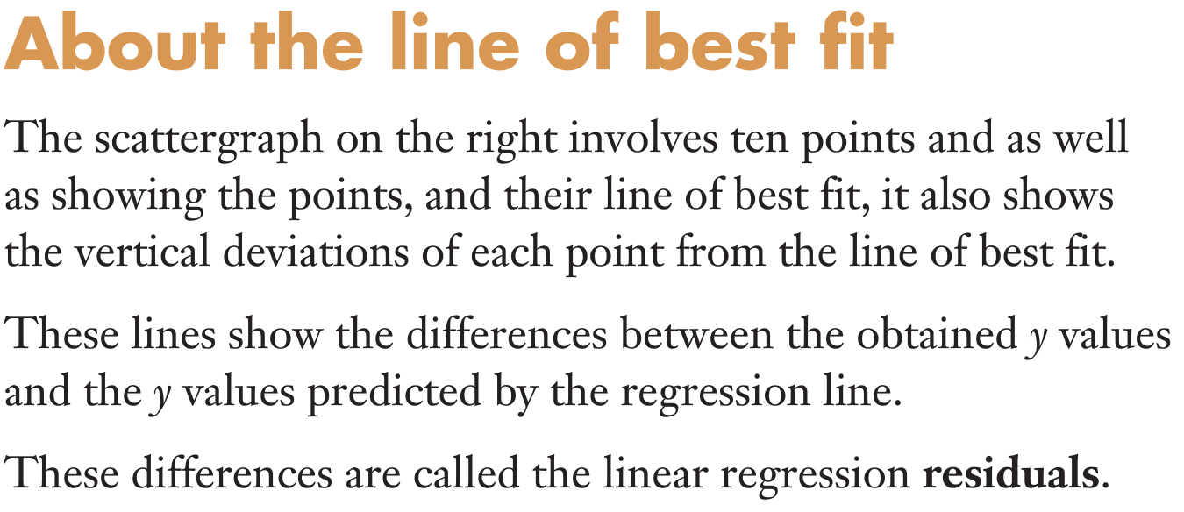
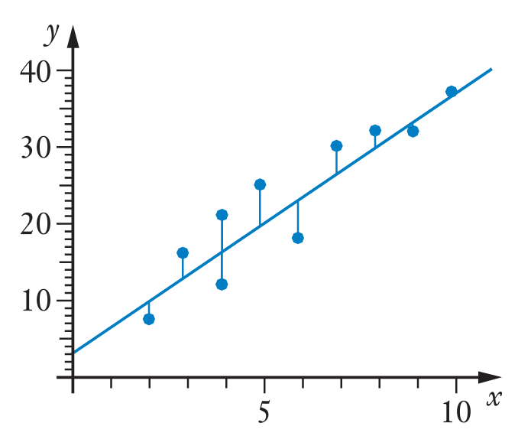
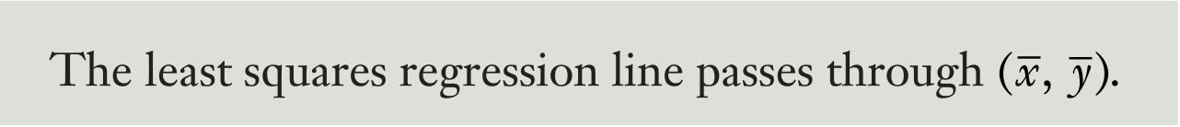
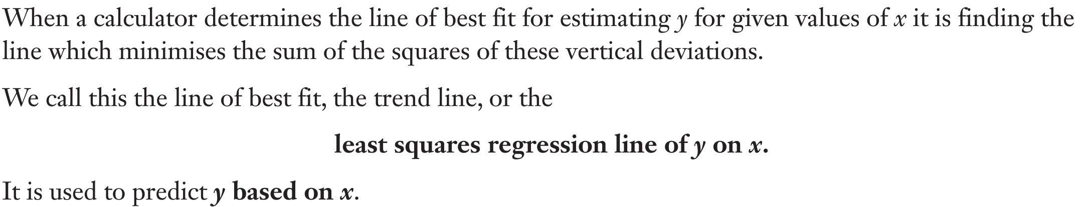
Topic: Least squares regression line and residuals
EQ: What is the relationship between a least squares regression line and residuals?

Slide 3
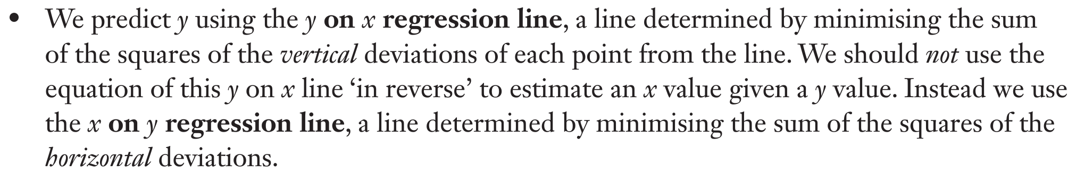
Topic: Least squares regression line and residuals
EQ: What is the relationship between a least squares regression line and residuals?

Slide 4
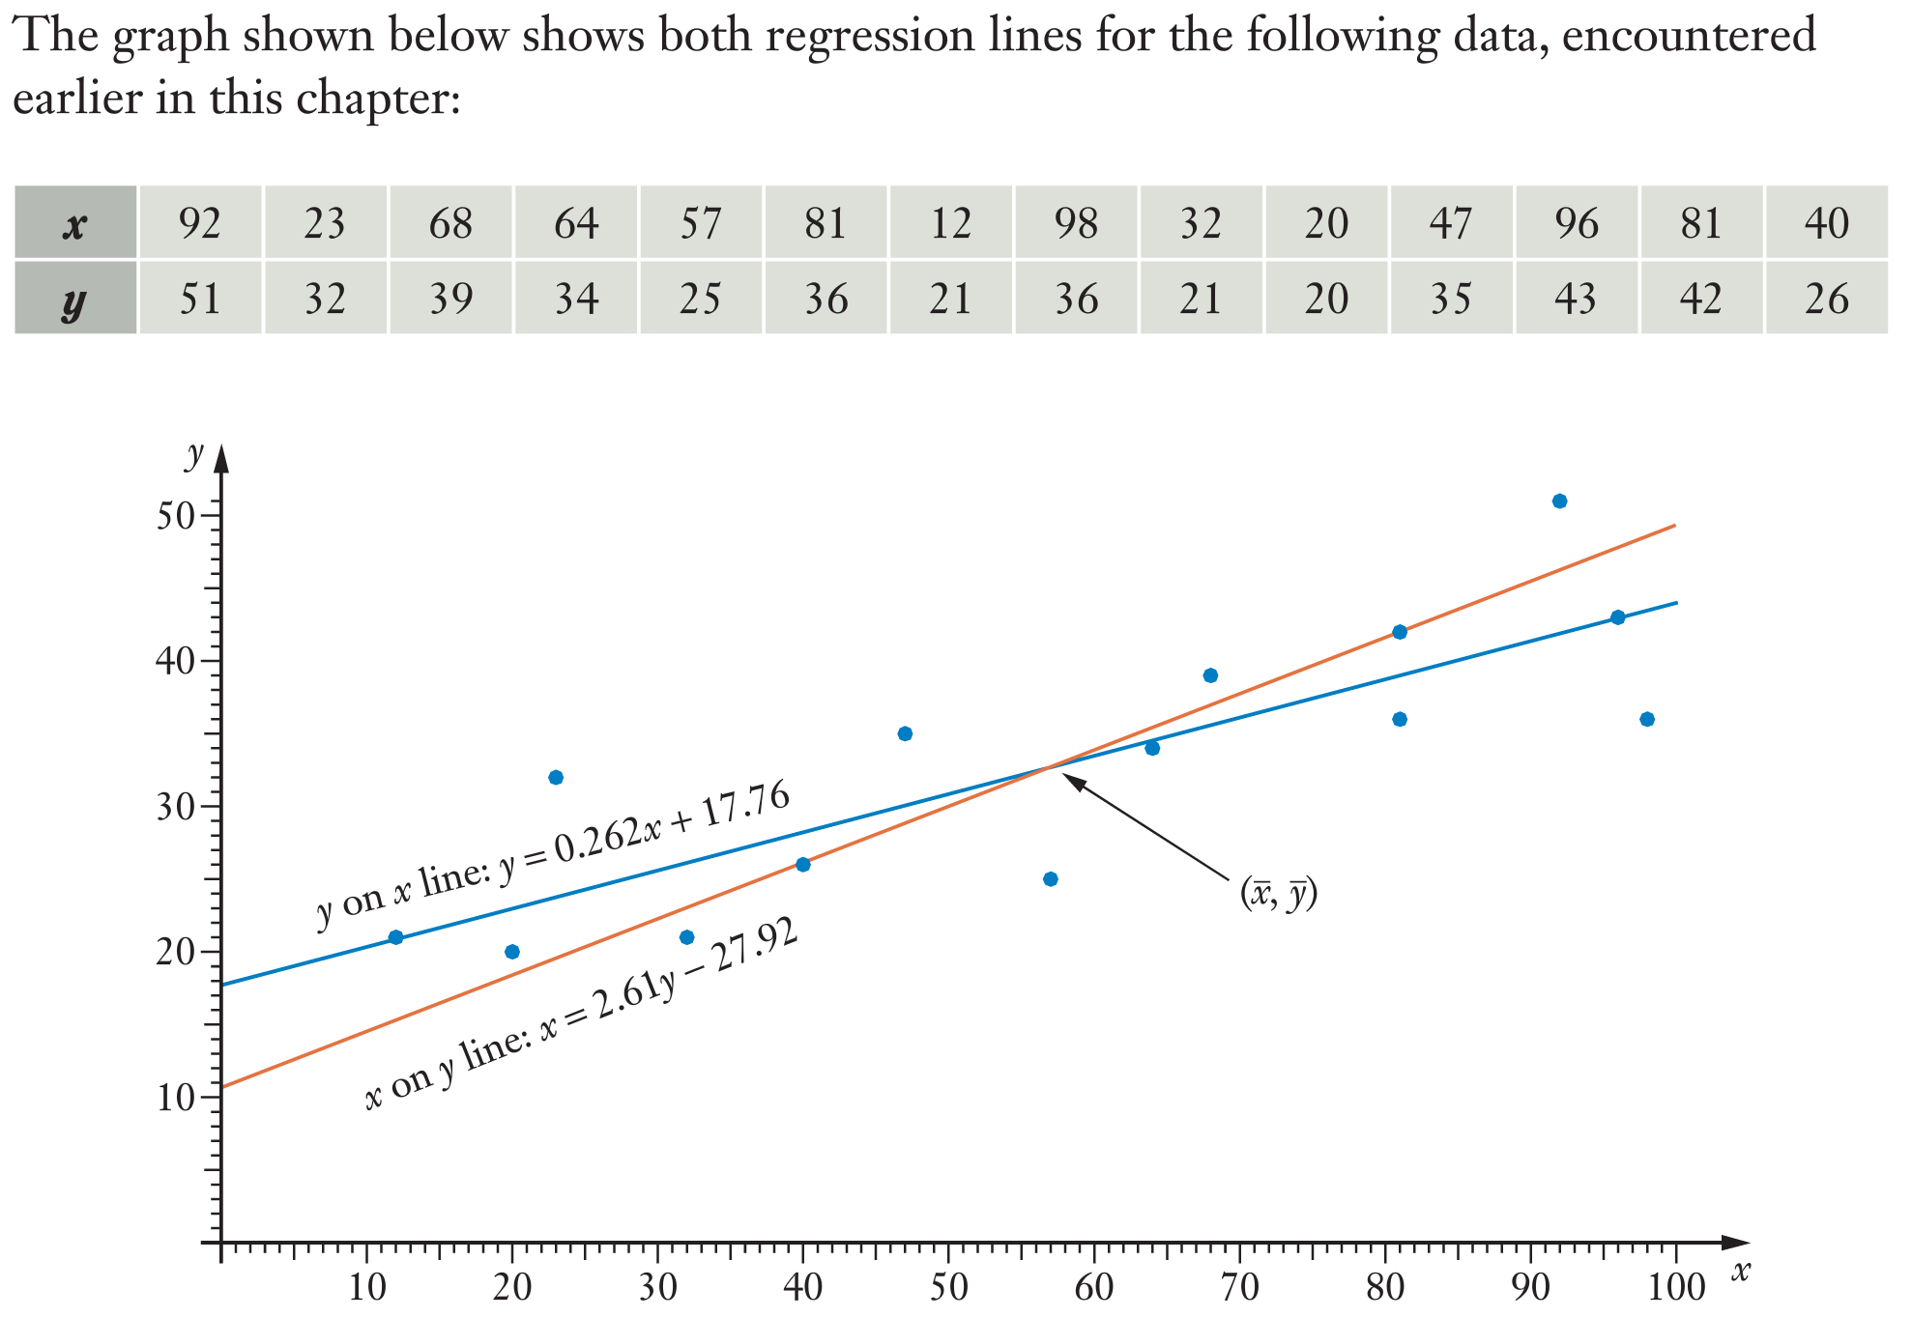
Topic: Least squares regression line and residuals
EQ: What is the relationship between a least squares regression line and residuals?

Slide 5
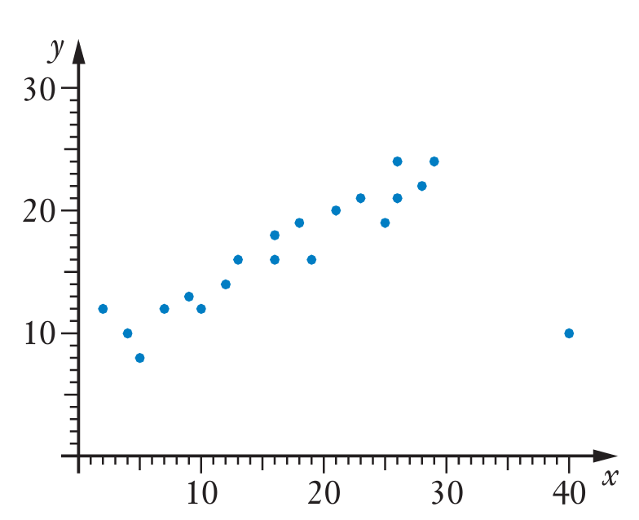
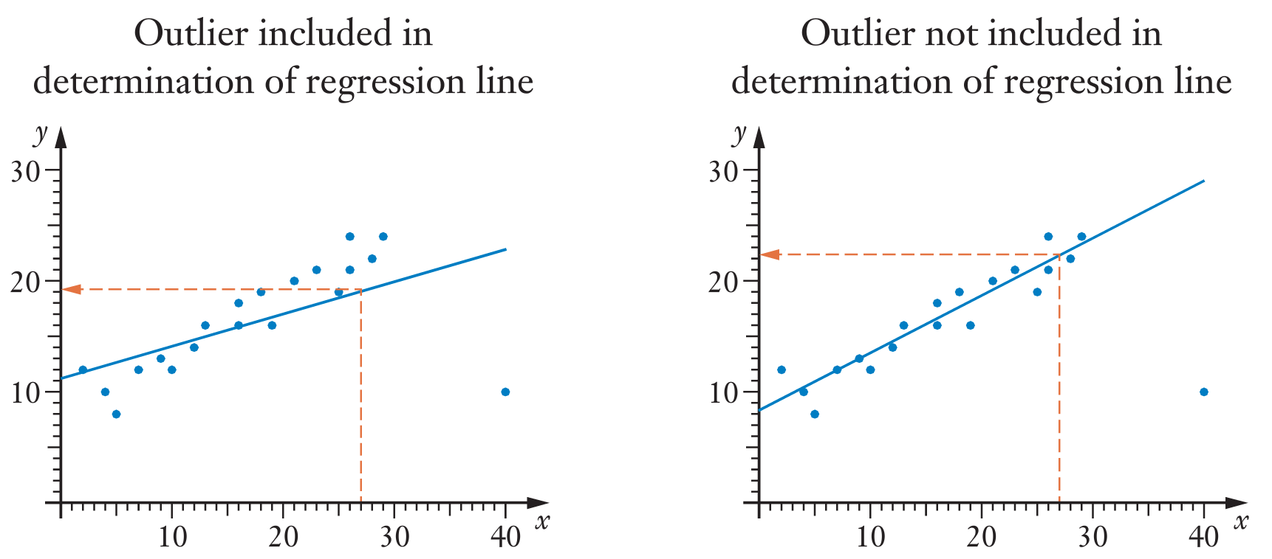
How to deal with outliers
Consider the graph on the left. The point (40,10) is out of step with the rest of the points and is considered an outlier.
Outliers can significantly alter the location of the line of best fit, as noted below
Sadlers advice is to remove outliers when calculating a line of best fit, but to also note that outliers must be investigated further

Slide 6
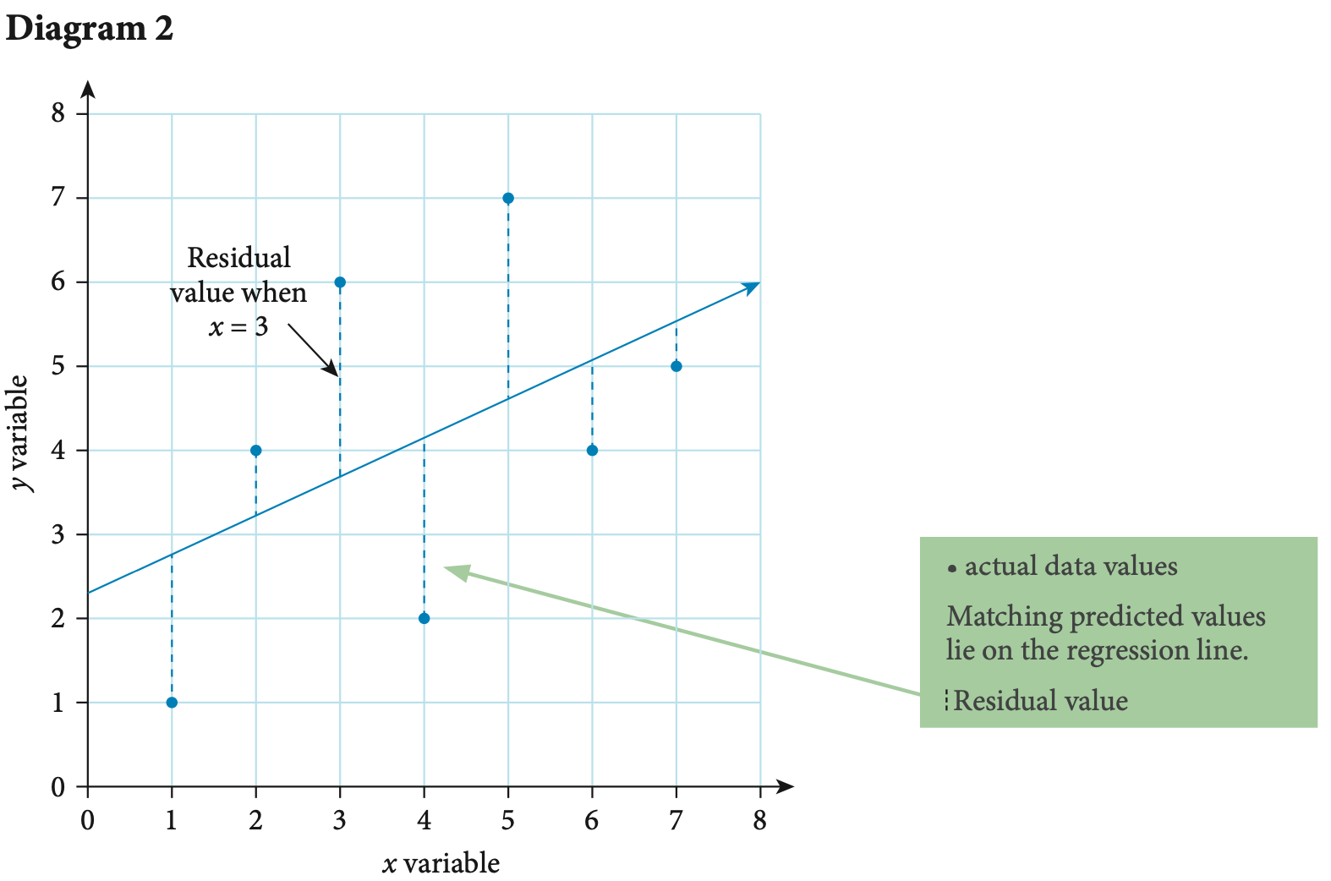
Residuals
Important
Residual = actual y value – predicted y value
The actual y value can either be stated, be found in the data table or read from a scatter plot
The predicted y value needs to be calculated using the linear regression model for the data

Slide 7
Residuals
Important points from Diagram 2
Actual data points that lie above the regression line will have a positive residual value
Actual data points that lie below the regression line will have a negative residual value
Actual data points that lie on the regression line will have a residual value of zero
The further the actual value is from the regression line, the larger the residual value

Slide 8
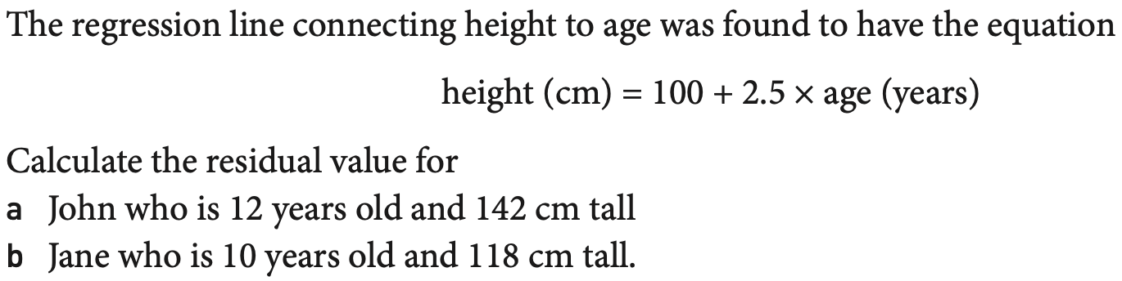
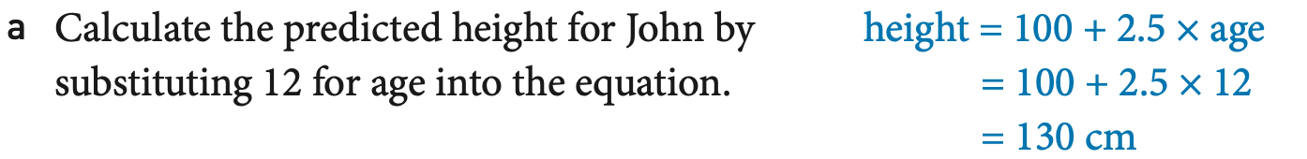
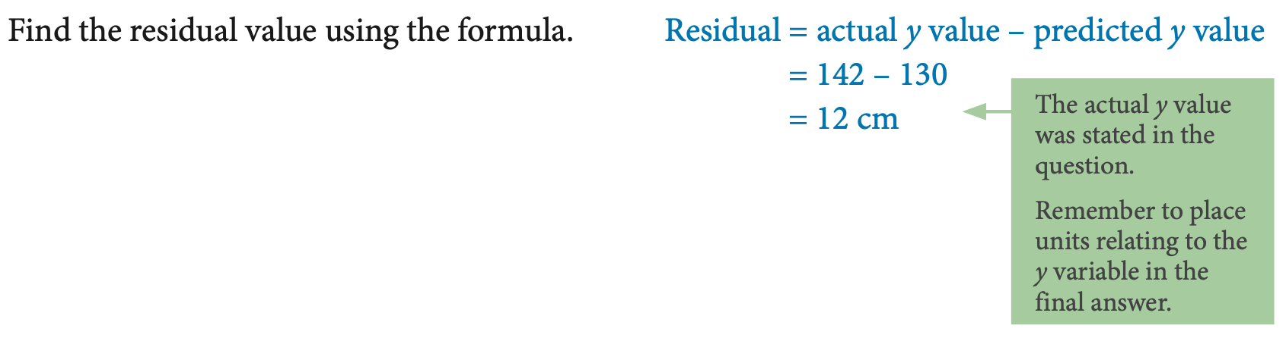
Example

Slide 9
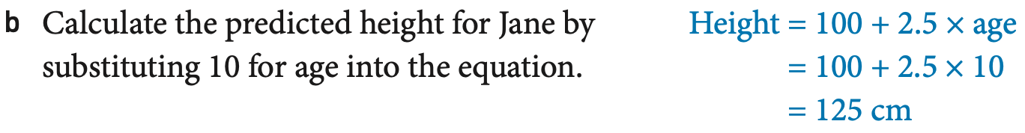
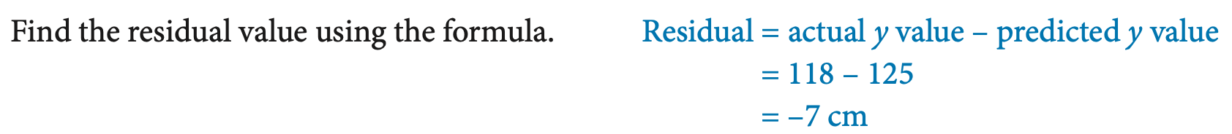

Slide 11
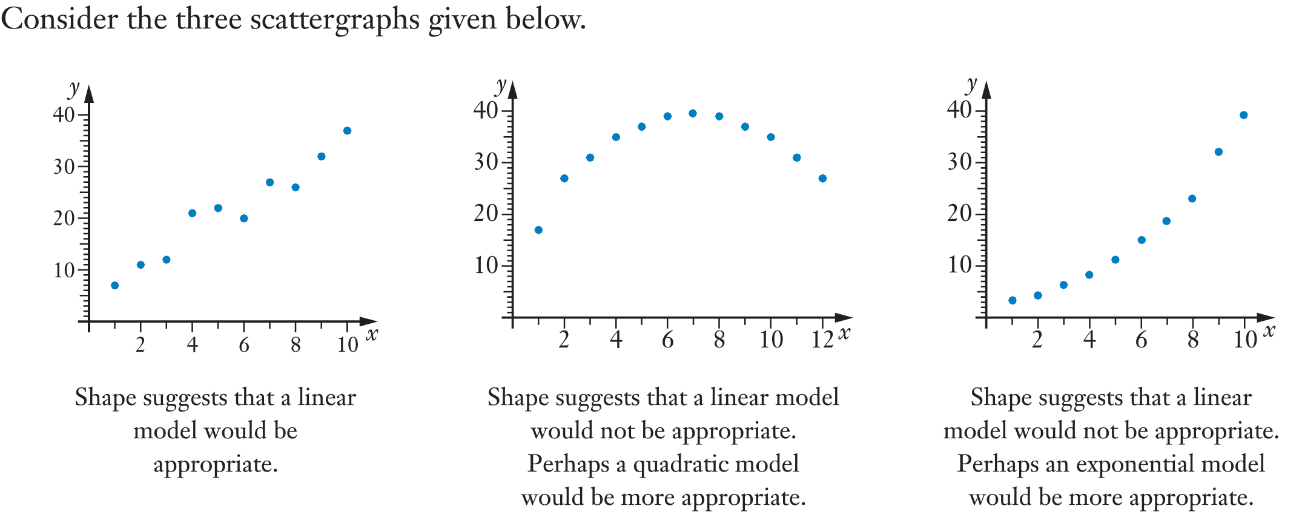
Reading Residual Plots

Slide 12
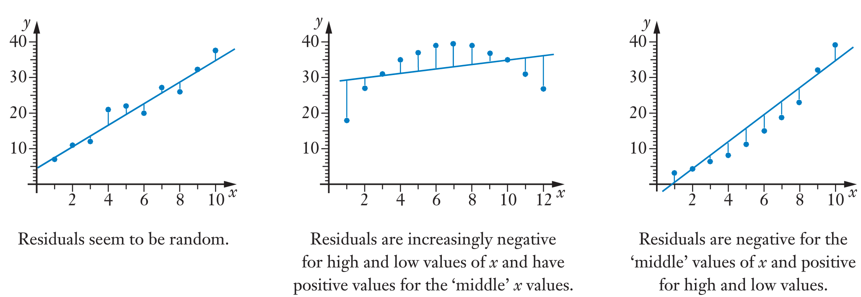
Those scattergraphs give the following residual plots
IMPORTANT: A residual plot that appears to be random suggests that a linear model is appropriate for displaying data

Slide 13

Practice
Residuals Worksheet
Notes:
Independent practice

